Slide 1
CSC 362: System Programming
Lecture 9
Original slides by: Amitabha Dey
Adapted by: Dr. Richard Johnson
Department of Computer Science University of North Carolina at Greensboro

Slide 2

Status Check
Compiling Multi-File Projects & Dependency Tracking
Basics of Makefiles
Targets, Dependency, Actions
What we will cover today
Advanced Makefile Application
Common Variables
Phony Targets
Pattern Rules
Automatic Variables
Conditional Directives
Recursive Make

Slide 3

Common Variables
In Makefiles, variables like CC and CFLAGS are commonly used to define the compiler and its flags, allowing you to customize how files are compiled and making the build process more flexible.
Using variables in this way simplifies the Makefile and makes it easy to modify the compilation options without changing each individual rule.

Slide 4
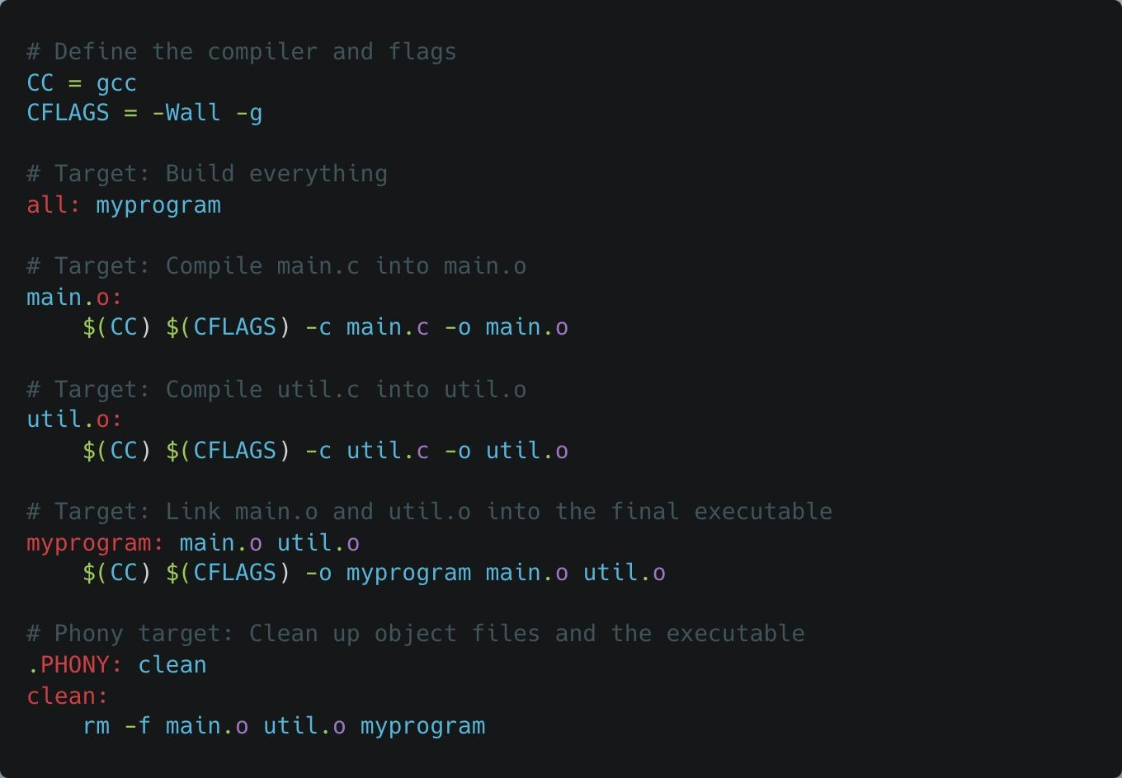
Common Variables
CC: This variable specifies the compiler to use. Typically, it is set to gcc (GNU Compiler Collection) for compiling C programs, but it could be changed to another compiler (e.g., clang) if necessary.
CFLAGS: This variable contains compiler flags, which are options passed to the compiler to modify its behavior. In this case:
-Wall: Enables all warnings. This flag helps catch potential issues in the code that could lead to bugs.
-g: Includes debugging information in the compiled binary. This flag is useful for debugging with tools like gdb.
Notes:
See example:
Phony Target directory

Slide 5
Phony Targets
Phony targets in Makefiles are targets that do not represent actual files. They are commonly used for performing actions such as cleaning up directories, running tests, or other administrative tasks that don’t produce or depend on files. Phony targets ensure that the Makefile doesn’t mistakenly treat these targets as files that need to be built, preventing conflicts if a file with the same name as the target exists.
Importance:
Phony targets are crucial because if a file with the same name as a target (e.g., clean) is accidentally created, the Makefile will treat that file as
up-to-date and skip the rule. By declaring a target as .PHONY, you tell make to always execute the rule regardless of whether a file with the same name exists.

Slide 6
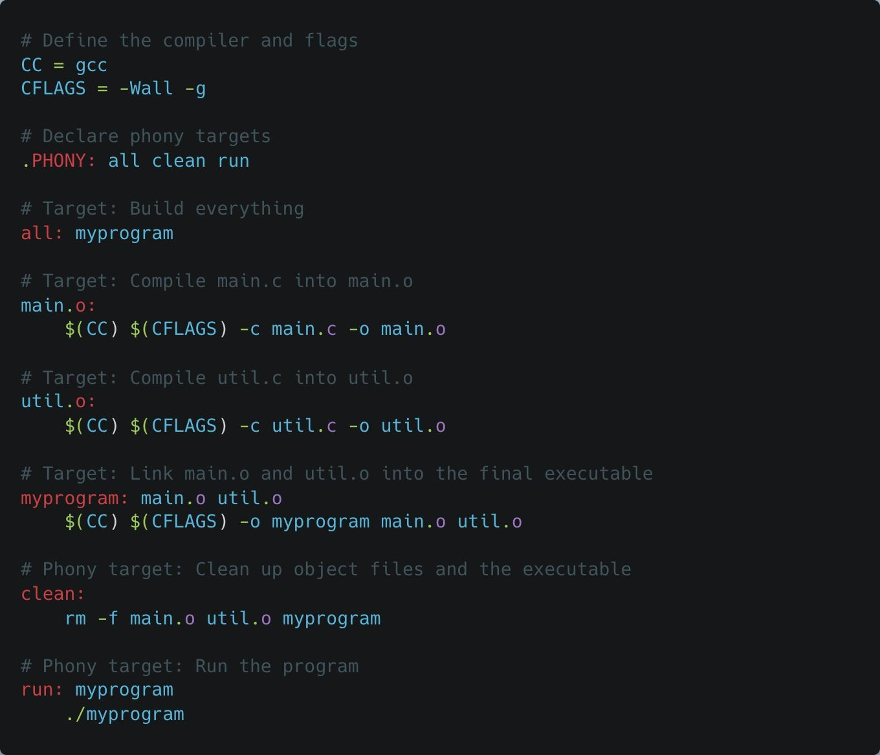
Phony Targets
all target: This is the default target that will build the entire project. It’s marked as phony to ensure that it is not confused with any file named all.
myprogram target: This target builds the final executable by linking the object files.
clean target: A phony target that removes all the object files and the compiled executable. Declaring it as .PHONY ensures that even if a file named clean exists, the rule is still executed.
run target: A phony target that executes the compiled program.

Slide 7
Phony Targets
Phony Targets in Makefiles Demo
Notes:
See example:
Phony Target directory

Slide 8
Automatic Variables
Makefiles provide several automatic variables that simplify build rules by referring to the target and its prerequisites dynamically. These variables are especially useful when managing complex projects with multiple files and dependencies.
Automatic Variables
$@: The file name of the target.
$<: The first prerequisite (often a source file).
$^: All prerequisites (all dependencies of the target).
These variables save time and effort in writing Makefiles by automatically referencing files based on the target and its dependencies. Below is an in-depth explanation of each, followed by code examples.

Slide 9
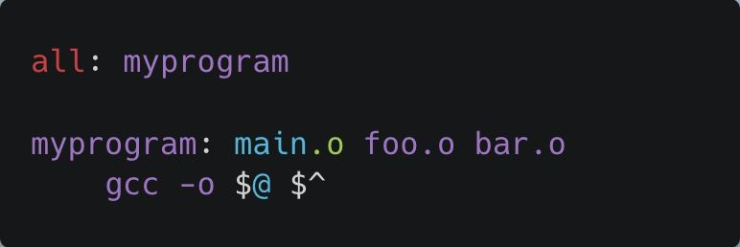
Automatic Variables
$@: The Target
$@ refers to the target in the rule.
The target is the file that the rule is expected to produce.
Target: myprogram
Command:
gcc -o $@ $^ will expand to
gcc -o myprogram main.o foo.o bar.o
$@ is the target, so it becomes myprogram.

Slide 10
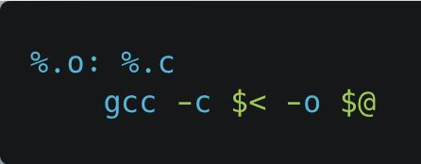
Automatic Variables
$<: The First Prerequisite
$< refers to the first prerequisite in the rule. It's commonly used in pattern rules to handle source files.
Target: A .o file (e.g., main.o)
Prerequisite: A .c file (e.g., main.c)
$< refers to the first prerequisite, which is main.c.
$@ refers to the target, which is main.o.
Command:
The command expands to
gcc -c main.c -o main.o.

Slide 11
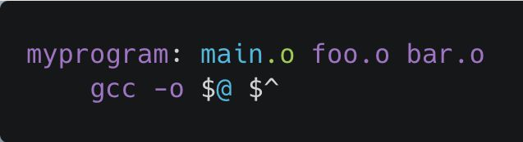
Automatic Variables
$^: All Prerequisites
$^ refers to all the prerequisites listed in the rule. This is useful when you need to pass all dependencies (e.g., object files) to the command in a single step.
Target: myprogram
Prerequisites: main.o foo.o bar.o
$@ refers to myprogram.
$^ refers to all prerequisites: main.o foo.o bar.o.
The command expands to
gcc -o myprogram main.o foo.o bar.o.

Slide 12
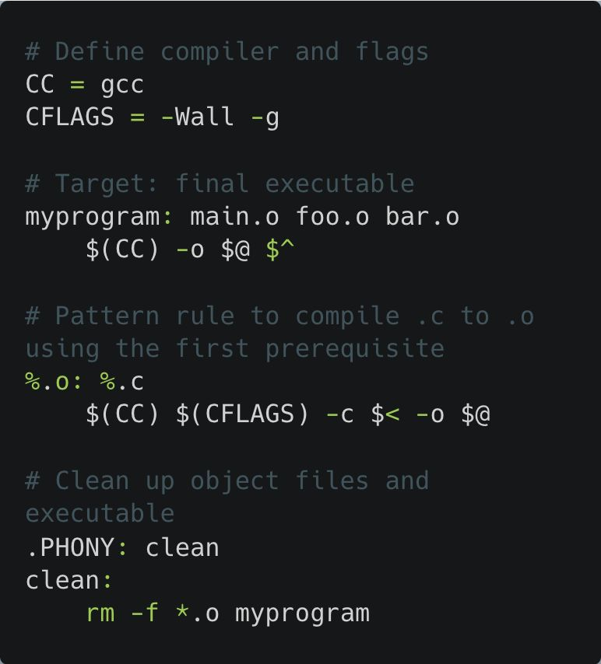
Automatic Variables
Automatic Variables in Makefiles Demo
Notes:
See example:
Automatic Variables directory

Slide 13
Pattern Rules
A pattern rule in Makefiles is used to specify how to build files that match a specific pattern, typically based on file extensions. This allows you to apply the same build command to multiple files without having to manually specify each one. It's especially useful for compiling source files in large projects.
% as a Wildcard
The % symbol in pattern rules acts as a wildcard, matching any string of characters. It enables a single rule to apply to multiple files that share a common pattern, such as compiling all .c files into .o files.
Pattern rules are often used in Makefiles to automate the process of compiling multiple source files into object files without having to list each file individually.

Slide 14
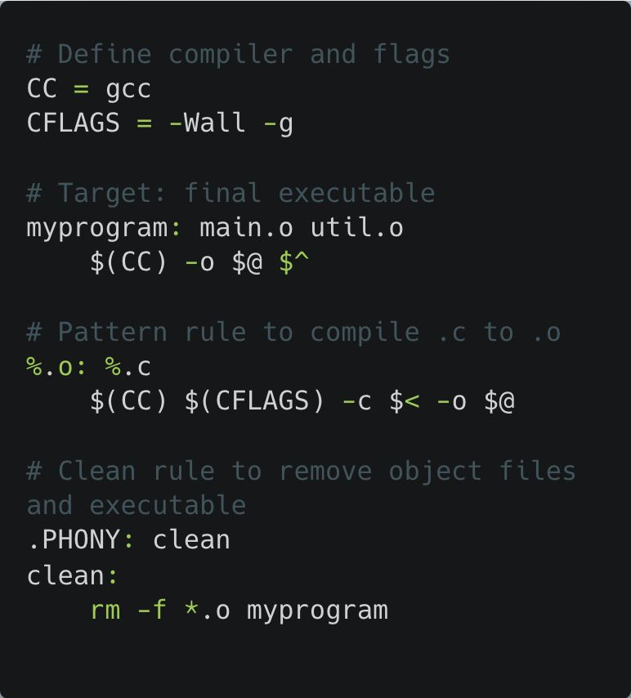
Pattern Rules
Pattern Rule: %.o: %.c
% matches any string of characters.
$< refers to the .c file (first prerequisite), and $@
refers to the .o file (target).
Explanation:
The target myprogram depends on main.o and
util.o.
The pattern rule %.o: %.c compiles any .c file into its corresponding .o file.
gcc -c $< -o $@ is used to compile, where:
$< is the .c file.
$@ is the .o file.

Slide 15
Pattern Rules
Pattern Rules in Makefiles Demo
Notes:
See example:
Pattern Rules directory

Slide 16
Conditional Directives
Conditional directives in Makefiles allow you to control the behavior of the build process based on certain conditions. This is particularly useful when handling cross-platform builds, where different operating systems or configurations may require different commands, compiler flags, or file extensions.
Make uses the following conditional statements:
ifeq (arg1, arg2): True if arg1 is equal to arg2.
ifneq (arg1, arg2): True if arg1 is not equal to arg2.
ifdef var: True if var is defined.
ifndef var: True if var is not defined.
You can also use else, endif, and else if for more complex branching.

Slide 17
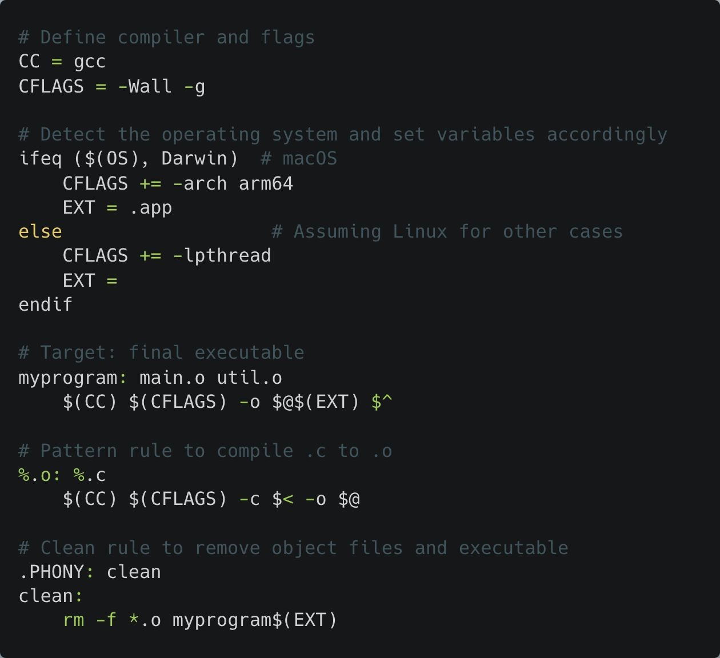
Conditional Directives
Detecting the OS:
ifeq ($(OS), Darwin): The variable OS is set by the operating system. For macOS, this value is Darwin.
If we are on macOS, the architecture flag -arch arm64 is added to CFLAGS, and the extension
.app is used for the executable (myprogram.app).
For Linux (any system where OS != Darwin), we add -lpthread to CFLAGS to link the pthread library, and the executable has no extension (myprogram).

Slide 18
Conditional Directives
Conditional Directives in Makefiles Demo
Notes:
See example:
Conditional Directives directory

Slide 19
Recursive Make
In large projects, it's often useful to split the build process across multiple directories and use different Makefiles in each directory. This modular approach helps keep the build system organized and manageable. Each subdirectory has its own Makefile, and the root directory has a "master" Makefile that controls the overall build process.
To build in subdirectories, you can use $(MAKE) to invoke make in each subdirectory. This ensures that the sub-Makefiles are processed in the context of the current make process.
$(MAKE): Used to call make recursively in subdirectories.
It is better than calling make directly because $(MAKE) preserves the flags and environment variables passed to the top-level make.

Slide 20
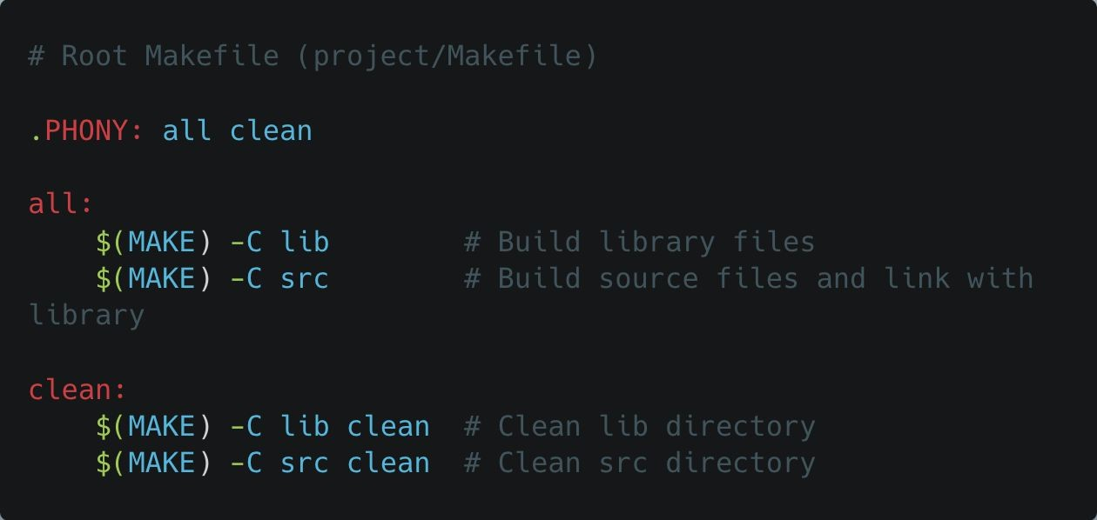
Recursive Make
Root Directory
Recursive Make Demo
Notes:
See example:
Recursive Make directory

